Slide 1



Explore Reinforcement Learning on Dynamic Routing in Intelligent Traffic Management System
Mohammad Ali Imam Al Morshed
Morium Akter
Supervised By:
Prof Dr. Shamim Akhter
International University of Business Agriculture and Technology

Slide 2
Motivation for Research
Static Environment
01
Optimal Path Finding is limited to static environment
Need More Efficiency and Less Time Consuming
02
We are trying to innovate real time optimal path for vehicles when the environment is dynamic and changeable.
Get Real Time Information
03
So, our goal is to apply “Reinforcement Learning in Dynamic Environment”. To help public find optimal path easily

Slide 3
Motivation for Research
Static Environment
Advantages | Draw backs
Reliability | Same path using again and again
Efficiency | Experience of the system impacts performance
Moving to Dynamic Environment – Why ?
Motivations | Challenges
Less time consuming | Reducing time and space complexity
More natural interaction | Adapting to the dynamic environments
Instant punishment can be avoided an d maximize the award

Slide 4
INTRODUCTION
01
REINFORMENT LEARNING
What is Reinforcement learning and Why
02
Applying ITMS in Reinforcement Learning
Why ITMS in Reinforcement Learning
03
Existing Solution
What are the Existing Solutions
04
Why Self Adapting
Works of Self Adaption

Slide 5
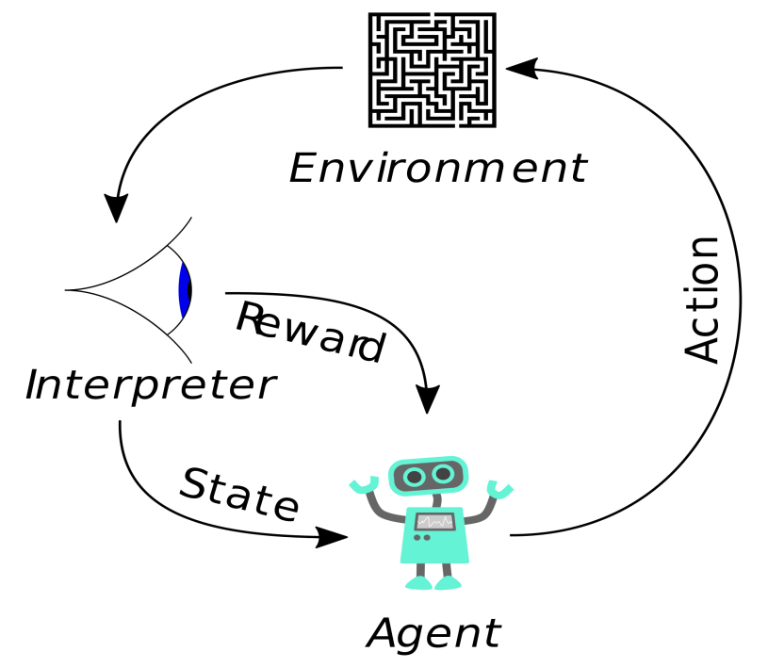
Reinforcement Learning
What does it do?
Tackles the problem of learning control strategies for autonomous agents.
.
What does it need?
This method assumes that training information is available in the form of a real-valued reward signal given for each state-action transition.
i.e. (s, a, r)
.

Slide 6





Applying ITMS in Reinforcement Learning
Information and communications technologies that improve the safety, efficiency, and performance of the transport system.
.

Slide 7
Q-learning Algorithm
Existing solution
Goal Solution
Required check environment for all case
Automatic information transfer
ES-1
GS-1
Not real time for all the vehicle
Real Time
ES-2
GS-2
High time and space complexity
Less Time Consuming
ES-3
GS-3

Slide 8
Self Adapting
Self Adapting is Required - Why ?
Monitoring
Analysis
Resource variability
Changing user needs
System intrusions or faults
SELF ADAPTING
Executing
Planning

Slide 9
Objectives
01
Implement Static Q-Learning in ITMS
How Q Learning work in Static Environment and why
02
Implement Dynamic Q-Learning in ITMS
Dynamic Environment Procedure and functionality
03
Intergrade Q- Learning with sumo tool and simulate the model
Applying ITMS in SUMO Tool

Slide 10


Implement Static Q-Learning in ITMS
Identify an optimal action selection policy
Obstacles are static

Slide 11
Q-learning Algorithm
Initialize Q(s, a) arbitrarily
Repeat (for each episode)
Initialize s
Repeat (for each step of the episode)
Choose a from s using an exploratory policy
Take action a, observe r, s’
Q(s, a) ← R(s, a) + * max Q [ st+1, action ]
s ← s’

Slide 12



Implement Dynamic Q-Learning in ITMS
Algorithm for Dynamic Environment: Q(s, a) ← Q(s, a) + α[r + γ max Q(s’, a’) – Q(s, a)]

Slide 13
Result Analysis
Proposed method proved to be 95% accurate against the environment comprising of Static Q-Learning.
Study | Movement | Reward | Punishment
Number of Movement | 20 | 19 | 1
Classifier | k-NN | NCC
Number of Testing image | 1000 | 20
Overall % recognition | 100% | 95% | 5%

Slide 14
Time and Cost
Using Free Desktop Application- PyCharm
Using Free simulation tool
Estimation Cost
Cost
Time
All about 7 month
Research- 1 Month
Work in Static – 2 Month
Implement Static – 1 month
Research and Implement Dynamic
– 3 Month
Estimation Time

Slide 15
Conclusion
We know Now-a-days traffic is a one of the main problem in our society. So we are trying to introduce a new model with people. In this model people can choose efficient route to go their destination. As Q-Learning is a reinforcement learning process, This model learn atomically from environment based on maximum reward. Then give the optimal route as output.

